Slide 1
Virtual SFM

Slide 2
What is SFM-MVS
Generating 3d georeferenced pointcloud from imagery
SFM to calculate poses
MVS to generate dense pointcloud

Slide 3
Where is current research focused
Accuracy
Applications

Slide 4
Limitations in current research
Time ($) to acquire imagery, collect control data with GPS/Lidar
Lack of control of independent variables
Object texture, sunlight, camera positioning, camera intrinsics, camera exposure, camera blurring
Lack of accuracy of control data
GPS and lidar have errors which propagate through into the assessment
Lack of repeatability
Difficult for two researchers to do the same exact experiment

Slide 5
Concept: Virtual World for Experiment Design
You can simulate cameras, imagery, texture, lighting, refraction, etc, in a controlled environment with known accuracies
Exact placement of objects and cameras

Slide 6
Big Picture
User generates XML Files to generate data
Scene
Sensor
Trajectory
Render Engine Generates Imagery, control data
User runs SFM-MVS software how they’d like
Accuracy Metric Calculations
Point to plane, density, slope, aspect, noise, etc
User tests hypothesis using accuracy metrics

Slide 7
Part I: Imagery+Metadata Generation
Software to allow geomatics/SFM researchers an easy method to generate simulated UAV imagery
Ideally someone would get the “output” folder and have no idea that it was from a virtual environment and not a real UAV
images.JPG
Control.txt
Log.txt
Marker.txt
Model.obj
Sensor.xml
Trajectory.txt
Scene.xml, Sensor.xml
Trajectory.xml
SceneLibrary.xml
Renderer
Image
Filtering
(distortion, noise, etc)
SFM-MVS
Software
Pointcloud.las
CameraPoses.txt
CameraIntrinsics.txt

Slide 8
Part II: Accuracy Assessment
Give users of part I an easy way to assess a bunch of metrics from their pointcloud
Make it easier to test hypotheses by making the analysis easier
Accuracy
Density
Slope
Curvature
Pose error
Calibration error
etc
Accuracy Assessment
Pointcloud.las
CameraPoses.txt
CameraIntrinsics.txt

Slide 9
Part III: Leverage Workflow for experiments
Effect of Nadir vs Oblique Imagery on pointcloud accuracy and density
Effect of RTK GPS on accuracy in different environments
Effect of texture on pointcloud accuracy
Effect of sidelap on accuracy
etc

Slide 10
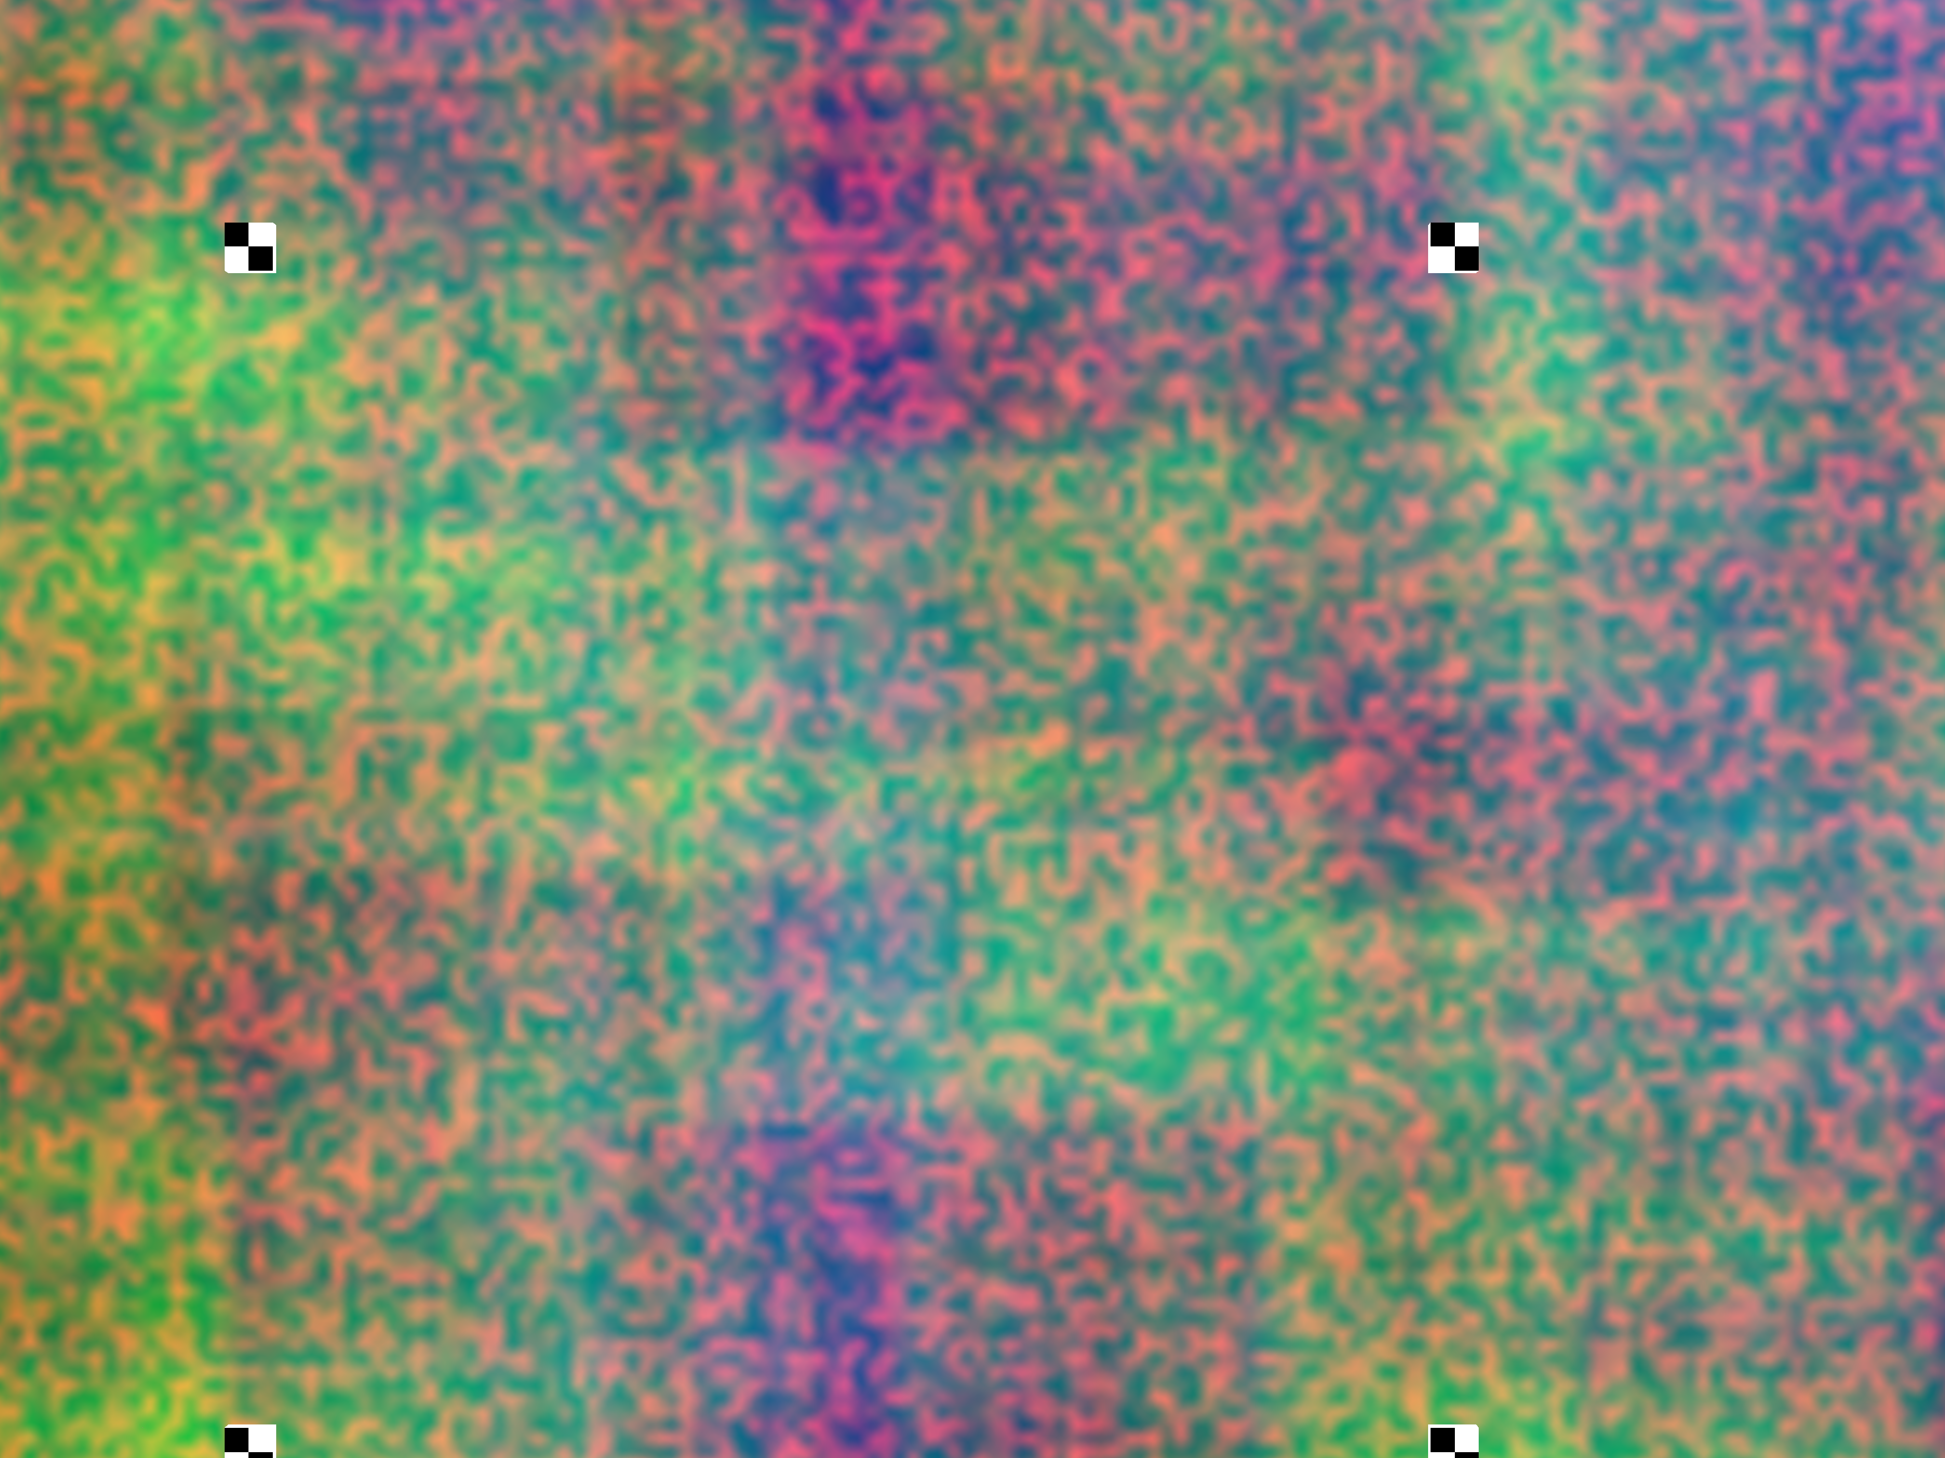
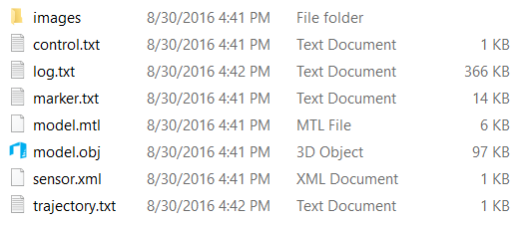
Using Blender + Python Scripting as Renderer
Developed workflow to make and render a scene using Blender
User input objects rotation, translation, scale
User input camera parameters
User input trajectory
Output imagery and metadata

Slide 11
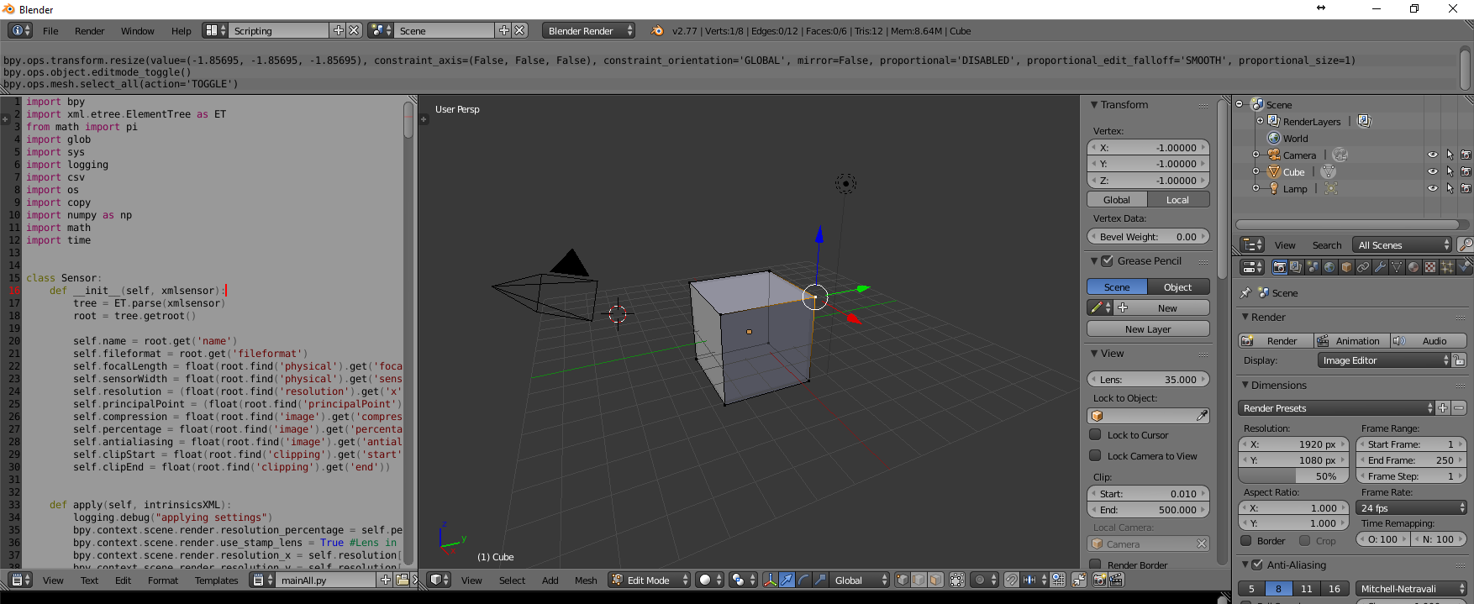
Blender Object Placement Validation
Object placement via scene.xml
Manual Inspection of vertices in Blender Application

Slide 12
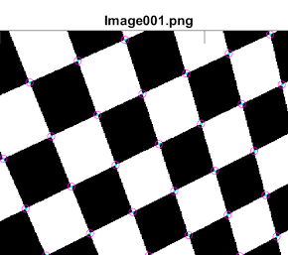
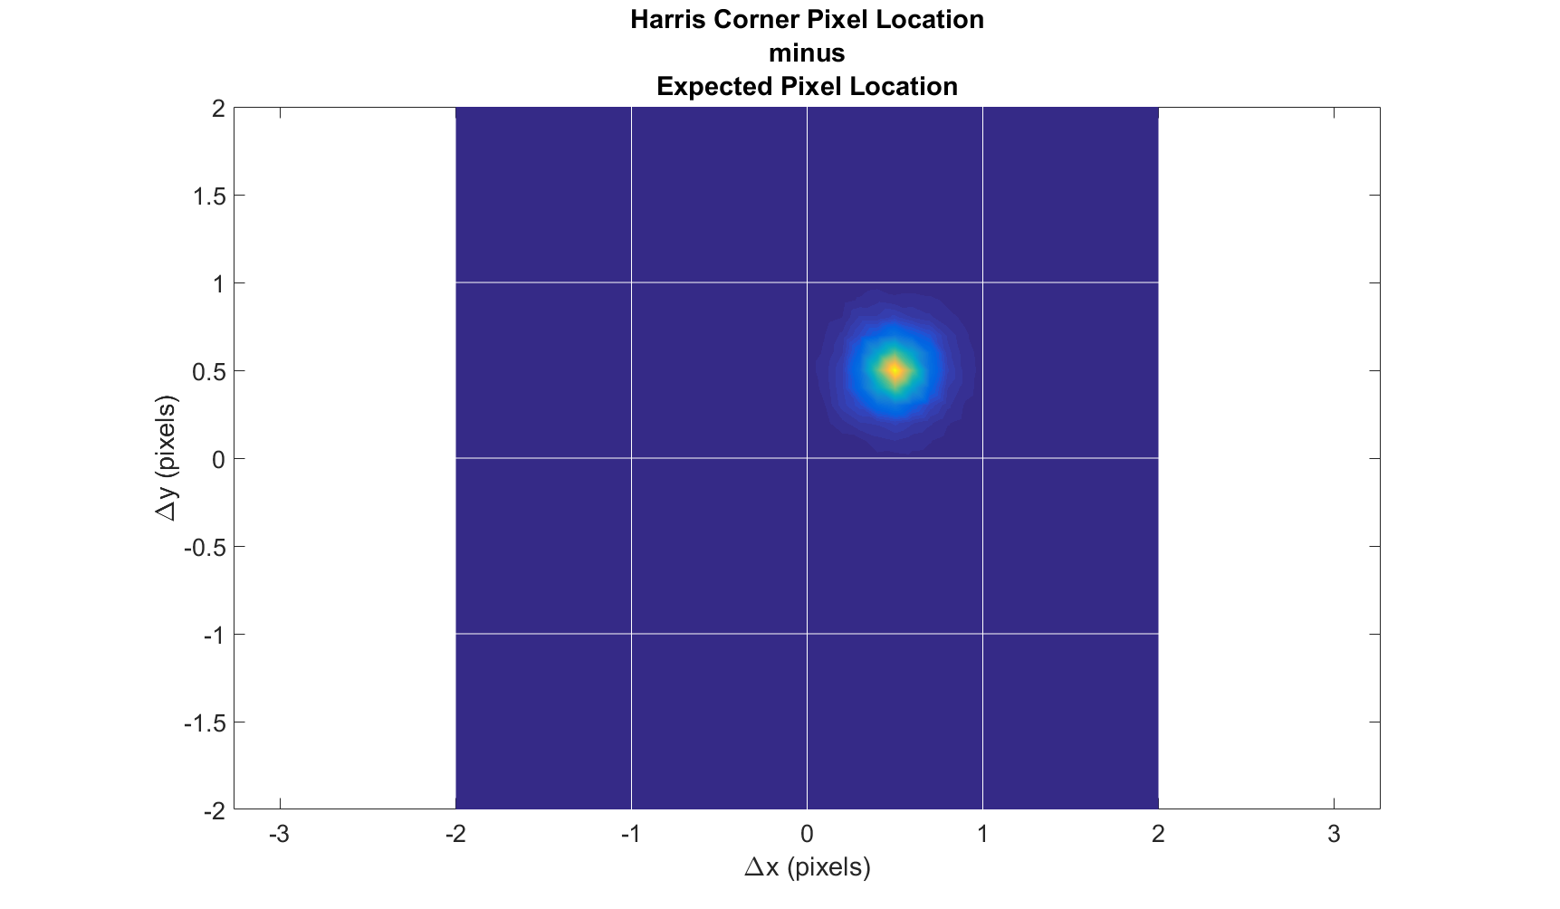
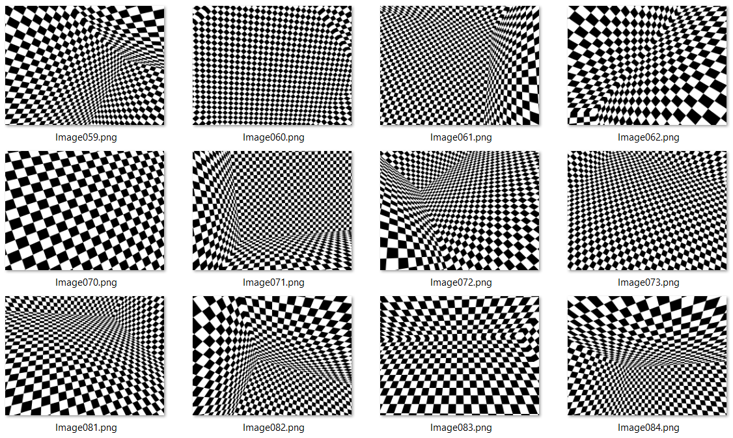
Blender Photogrammetric Validation
Developed a checkerboard “room” and moved cameras around the inside with 100 random translation, rotations
Used 5 different focal cameras
Extracted Corners in Matlab using Harris
Compared to expected projected based on camera
Half Pixel Bias

Slide 13
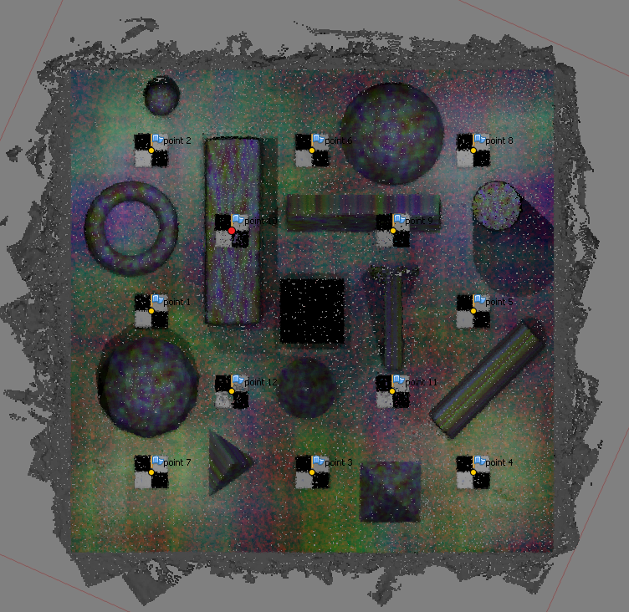
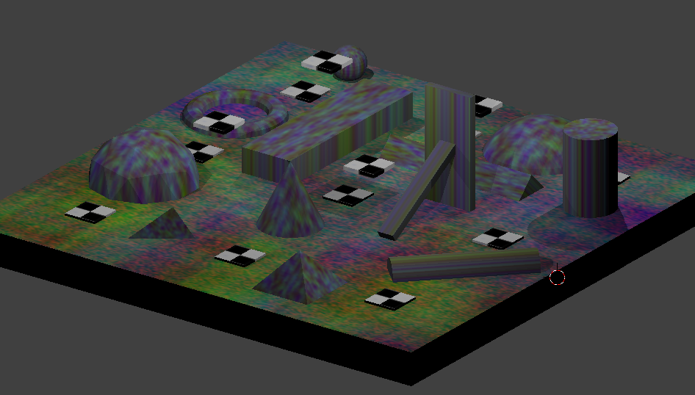
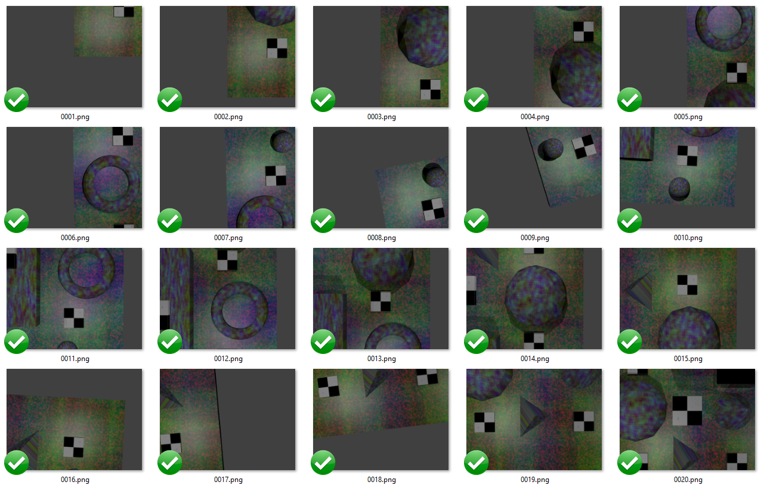
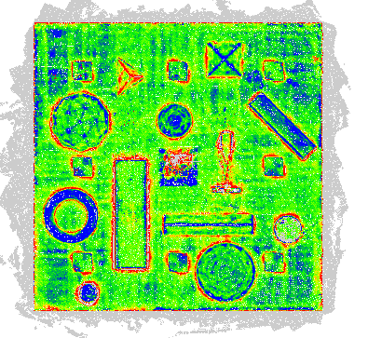
Proof of Concept
Photoscan Pointcloud
Scene in Blender
Render Images
Error Assessment

Slide 14
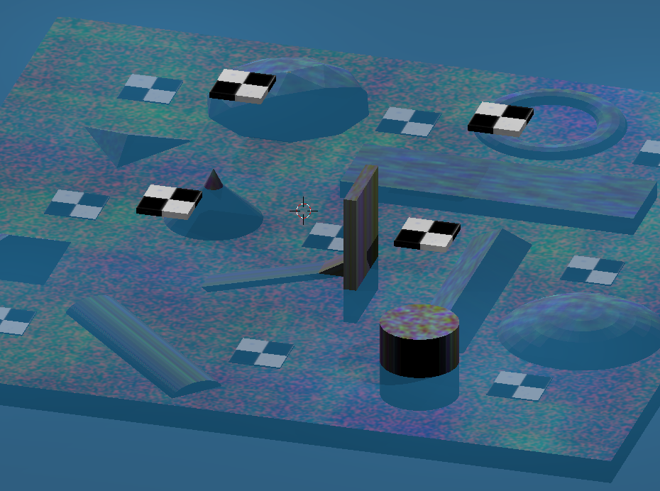
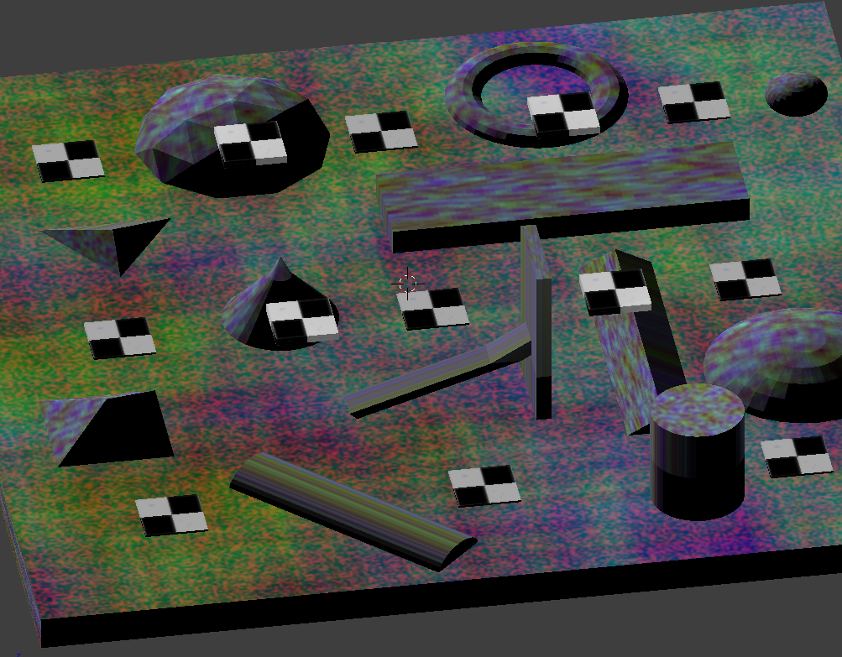
Blender Simulating Water Refraction
Add 3 meters flat water
Some structures half in water
Colored blue just for this figure

Slide 15
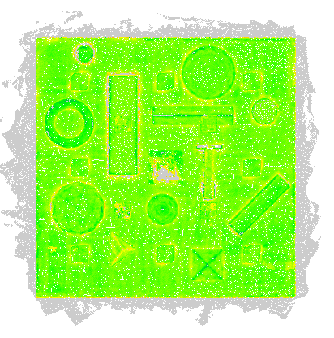
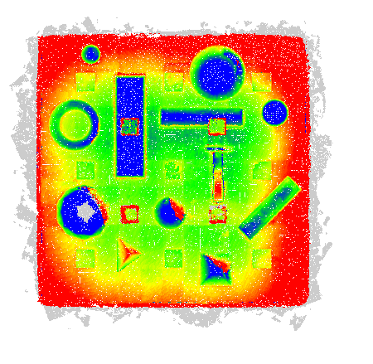
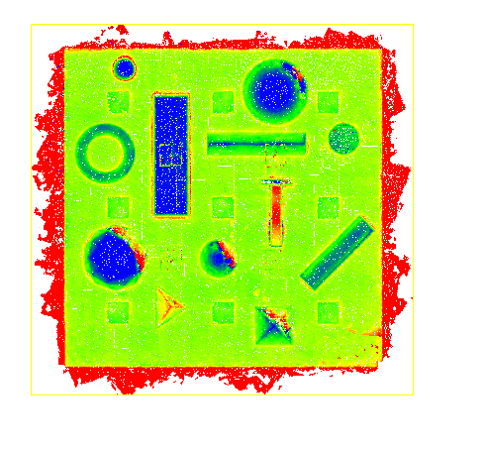
Error Assessment after Photoscan Processing Using Known Camera Calibration (Fixed) vs Solving with SFM (Float)
No Water
Intrinsic Float
Water
Intrinsic Fixed
Water
Intrinsic Float
caxis = [-0.2 0.2]

Slide 16
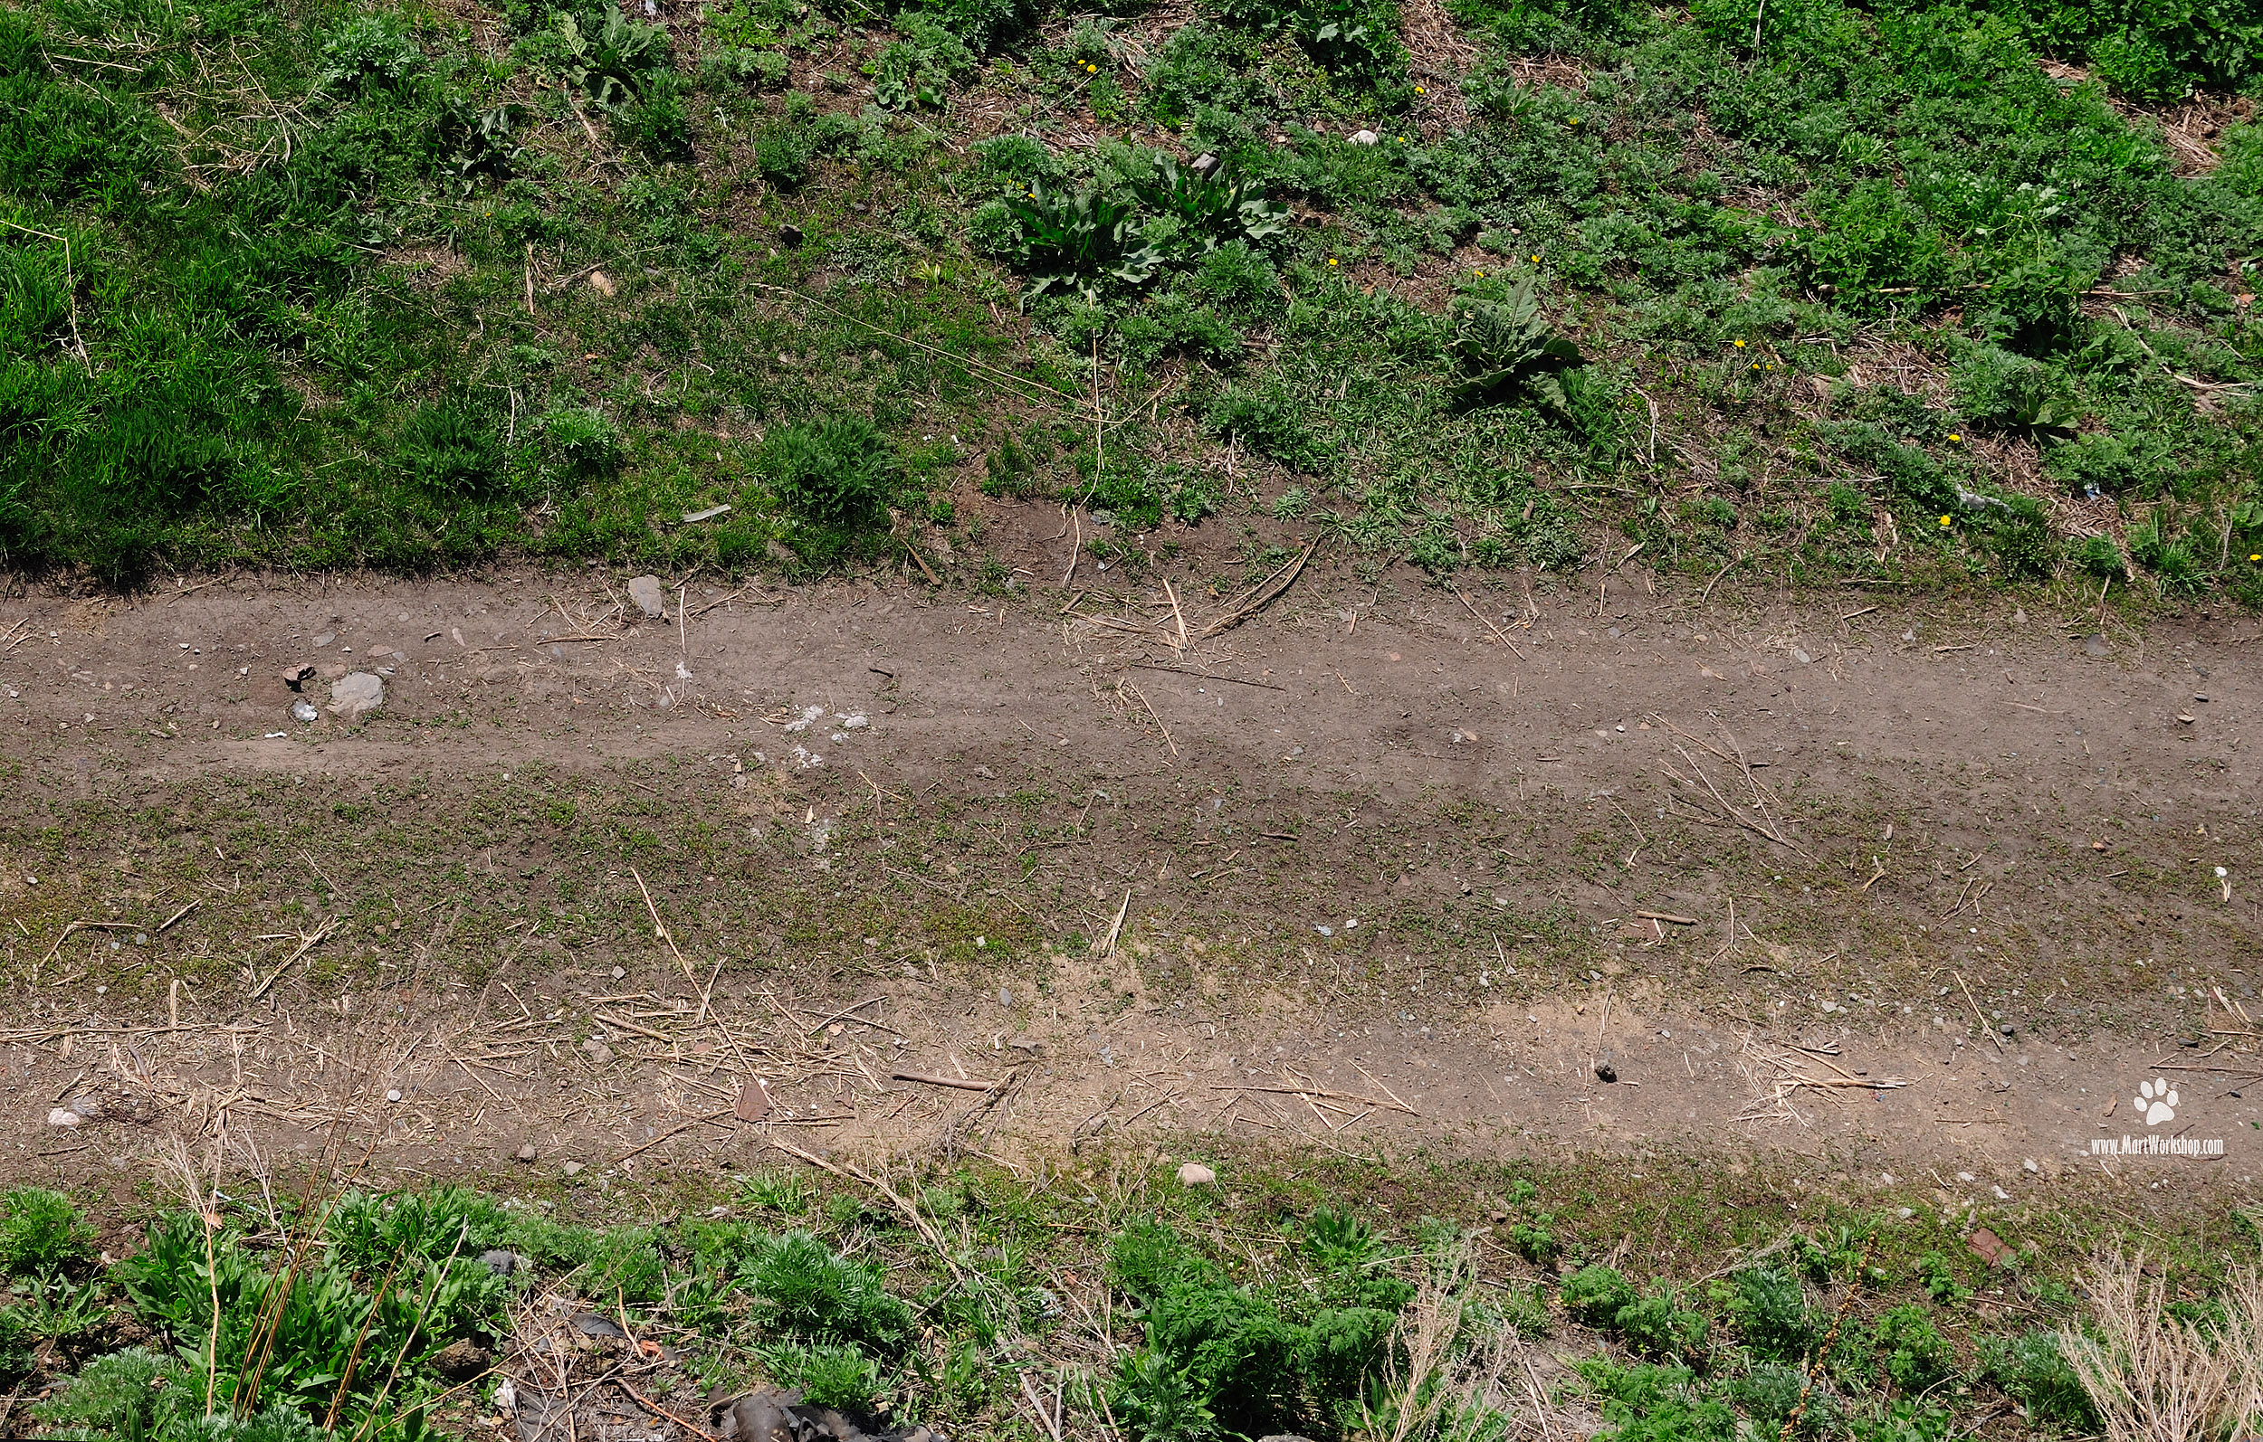
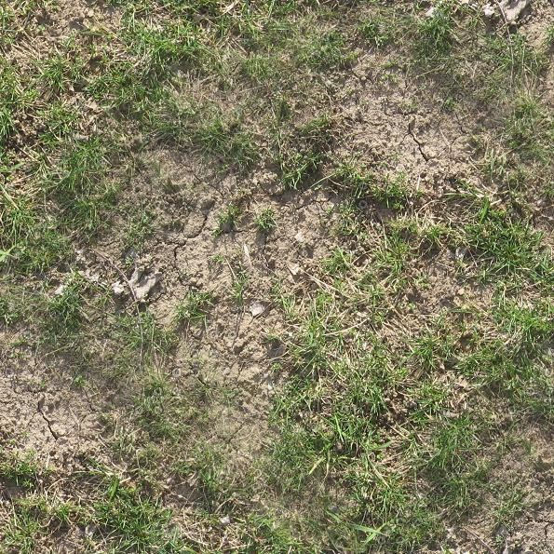
ToDo: Add Material Input in XML
How to generate cm scale resolution over 100m x 100m plane
Option A: 10,000 x 10,000 image as texture
Might crash Blender, not scaleable to km scale field site
Option B: Tiling and Layering
Tile the same textures repeatedly, and layer various textures
Currently the texture is set by the obj file
This means for any texture, a new obj file must be made
Goal is to have a default texture for every object, but also a “textures” folder which the user can pick from

Slide 17

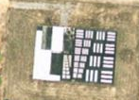
ToDo: Validate Material Texture resolution/sharpness
Need to make sure that if the resolution of the imagery isn’t being downsampled or smoothed by the renderer
Seimens Target
Tribar array

Slide 18
ToDo: DOCUMENTATION
Document focal length validation
Document principal point validation
Document Order of Rotations in Blender
(Maybe want to use quaternions for this since Blender Euler is inconsistent)
Generate More OBJ files
Develop Image post-processing Script (vignetting, distortion, noise, blur)

Slide 19
ToDo: Decide on Committee
Potential Committee Members? (in no particular order)
GCR: Mike Bailey (Computer Graphics)
Mike Olsen
Craig Glennie
Michael Starek
Rob Fisher (ERDC-GRL doing SFM work)
Craig Rodarmel

Slide 20
Extra Stuff
Github repo: https://github.com/hokiespurs/BlenderPythonTest
Need to get me to give you access so you can see issues, and code updates
Need a cool acronym
In Depth Details on XML format on next few slides

Slide 21
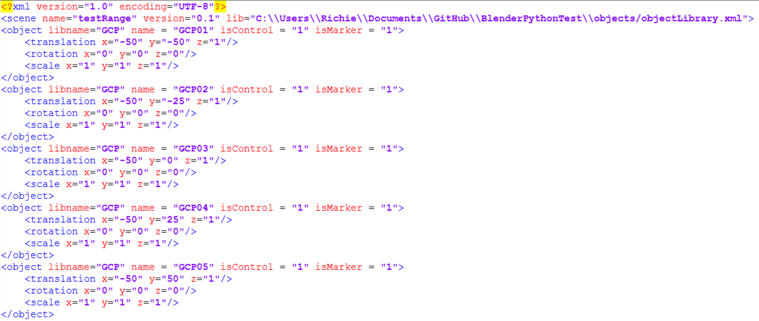
Scene XML Format

Slide 22
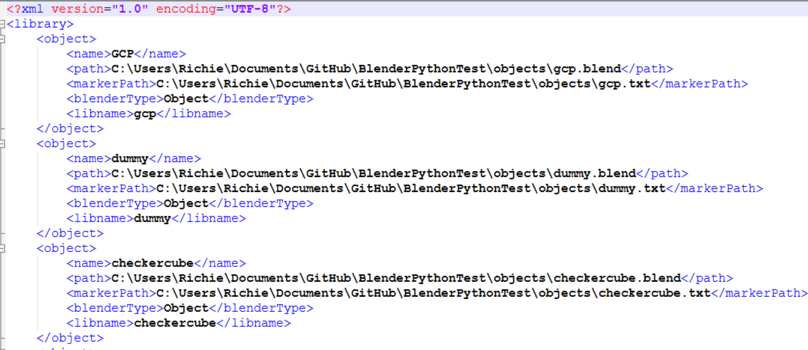
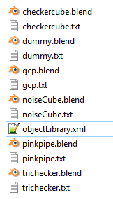
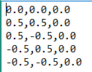
Object Library
objectLibrary.txt
*.txt
Indicates local xyz coordinates of “markers”
0,0,0 of object defines “control”

Slide 23
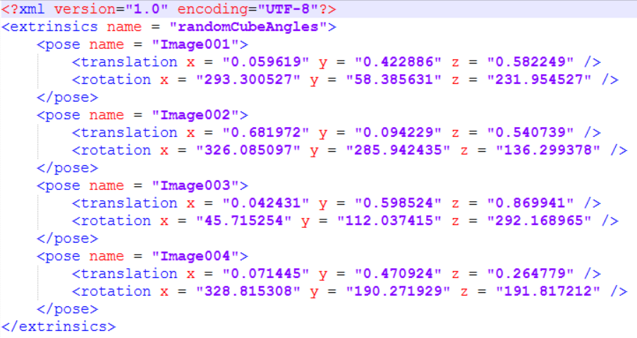
Trajectory XML format

Slide 24
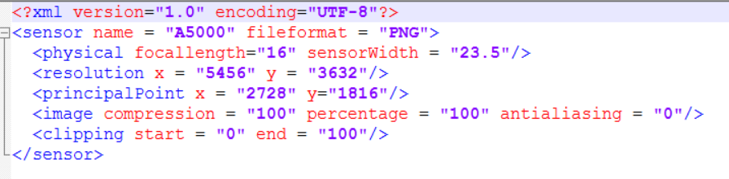
Sensor XML format

